Slide 1
@davidmehi

Slide 2
Introduction to the
Google Cloud Platform
A Guide to the GCP
David Mehi
davidmehi@google.com
@DavidMehi
@davidmehi

Slide 3
Introduction

Slide 4

David Mehi
Principal Architect
davidmehi@google.com
@DavidMehi
Notes:
Intro

Slide 5
Who are you?
Notes:
Before I get started I’d like to know who you all are. How many people develop full time? How many do systems work? How many do both? Do you do it cause you like devops, or because your company is punishing you? How many people here tell systems people or developers what to do?

Slide 6
Goal Help developers and sysadmins new to GCP figure out where the stuff they need is
Notes:
My goal with this session is to help sysadmins and developers who are new to GCP where to find the solutions to their problems on GCP.
I’m not going to talk a lot about competition.
I’m not looking to sell you one product or another. I’m trying to enable you to make the best choices on our platform.
Where we have a couple of products that overlap in what they can do, I’ll try and explain why you would choose one over the other.
For the most part I won’t bring up pricing. Where I do, it’s because pricing drives a large part of what makes that product different from other offering.
What I am going to do is start with problems or needs that people in tech have and explore down to where we have a product that can help. I’m going to try hard not to show our org chart.

Slide 7
Agenda
Computing
Networking
Storage
Big Data
Administration
Development
Machine learning
Notes:
I’m an Application developer at heart, so I’ll start with Computing and Storage. If you got questions, here’s your best opportunity for coherent answers from me. I’ll talk about Big Data here, but it’s not my area of focus, so expect C+ answers here.
Then I’ll talk about Networking, Operations. Answers to questions here: eh.
I’ll finish in Development, with a brief sojourn into Machine learning.

Slide 8
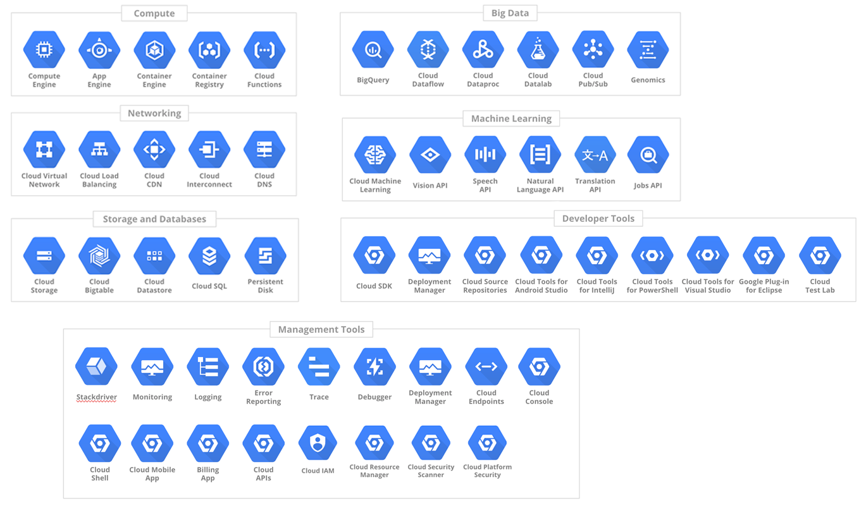
Notes:
This is a little harder than it looks. Cause here is how we typically list these.
There are over 50 products on this slide. We bunch them up and try to make them fit themes. But at the end of the day, almost everyone of these is can be an hour or several hours of talks. I’m trying to scrunch in.
Everyone in this room, probably has A problem that can be solved by something on this chart, but none of you will have all of the same issues, or end up with the same products. You probably will only need to deal with a fraction of it.
Which is why when you go to cloud.google.com, it can feel like overload.
Which is why I’m giving this talk
I won’t name everything. Why?
Was it that I couldn’t fit everything? Maybe.
Is it cause I’m not an expert in all of it? Probably.
Did the keynote give a lot of love to our big releases? Definitely.
Am I doing that thing where I ask questions then answer them myself? Absolutely.
8 Compute
10 data and storage
9 Networking
6 Administration
5 Developer
5 Services
43 talked about
53 on slide.

Slide 9
UI Overview
Navigating GCP
Notes:
Okay, computing, you know, doing things, analyzing or sorting stuff.

Slide 10
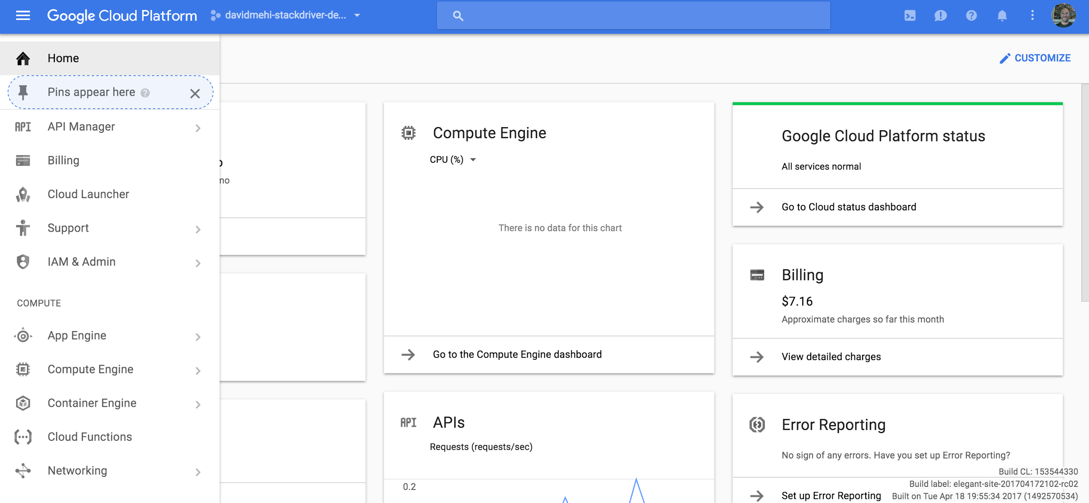
Navigating GCP

Slide 11
Computing
Doing things
Notes:
Okay, computing, you know, doing things, analyzing or sorting stuff.

Slide 12
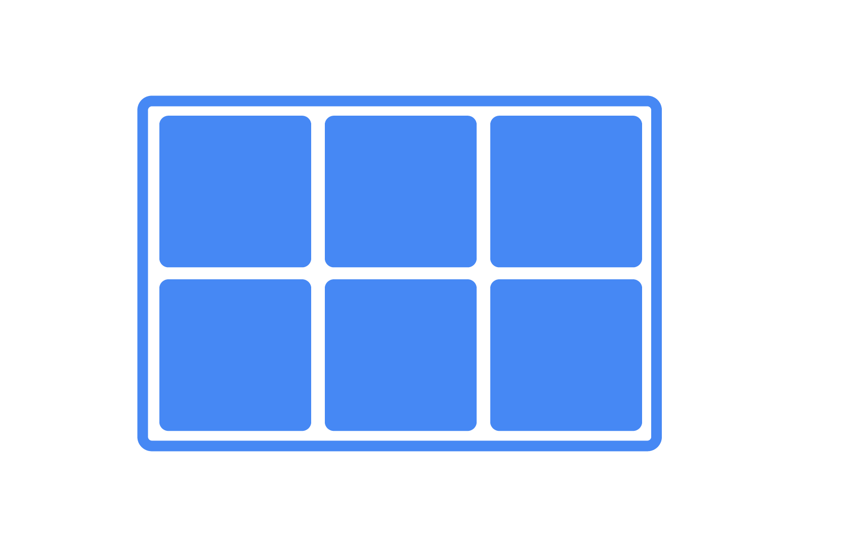
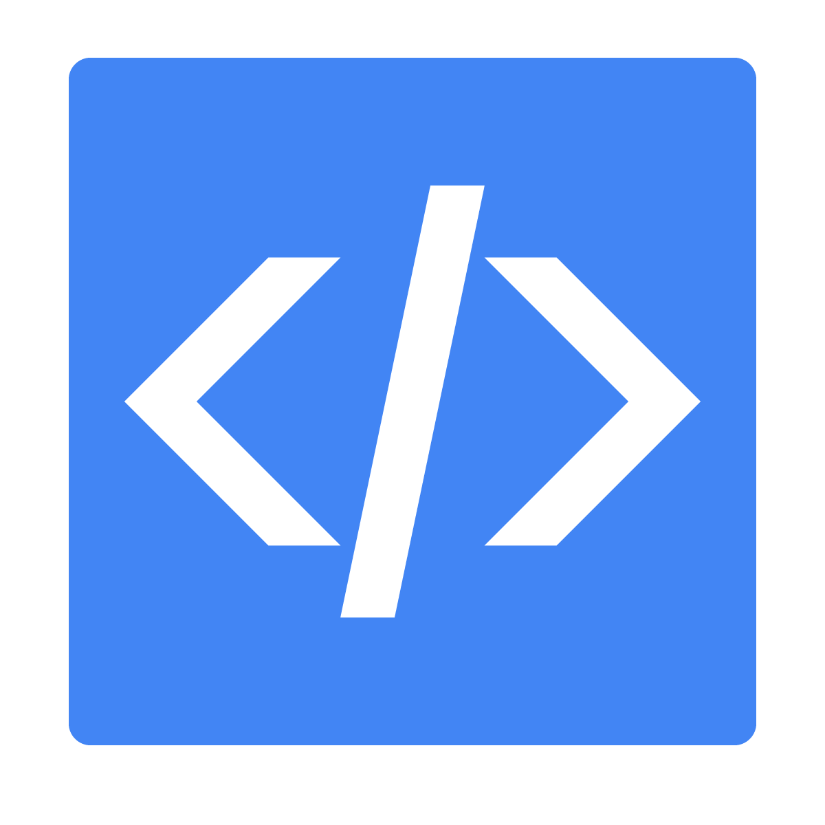

Computing
Virtual machines
Containers
Serverless
Notes:
Currently there are three likely paths for compute .1 building and configuring Virtual machines - or VMs. Second easier and easier ways to move to experiment with containers. Third, they are looking to ditch their systems and “go serverless.” Where they have code, and somebody runs that code for them independent of having to build and configure the actual systems that run this.
There are some of you who might remember the term “Platform as a Service.” Shhhhhhhhhhhh don’t tell anyone you know the dirty secret that Serverless is the name people use to market PaaS to people who fell into Gartner's trough of disillusionment.

Slide 13
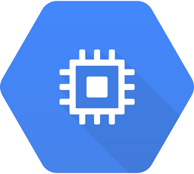
Virtual machines
Compute Engine
1 - 64 processors
.6 - 416 GB (.9 - 6.5 GB per proc)
Disk limits
65 TB Persistent
3 TB SSD
208 RAM
Preconfigured images
Can build your own (SUSE, Red Hat, Windows, etc)
Import existing images
Spin up in 10s of seconds
SSH through browser
Take snapshots
Notes:
So let’s start with VM’s
With Virtual machines, we have a pretty straightforward path. If you want a VM on GCP, you want Compute Engine. They are your basic virtual machine. You setup them up, you are root, you install what you want.
They’re pretty flexible in how you set them up. You can setup anywhere between 1 to 64 processors depending on your needs, and they you can assign memory equal to .9 to 6.5 GB per server. For example (with easy math) you choose 10 processors, you can have as much memory as you want between 9GB and 65GB.
You can choose from one of our prebuilt OS images, including debian, SUSE, Red Hat, and other linux distros. You can also pick from a couple of flavors of Windows. Yes Virginia, you can run Windows on GCP.
They’re very fast to spin up. We like to say they take 10s of seconds. As in you are in your hotel room testing things out, they spin up in 20 seconds. If you are speaking and demoing this in front of an audience, they take 80 seconds. I don’t how they know, but they know. In my experience, can expect a GCE instance to spin up and be doing work in about 60 seconds.
One of the other great things about GCE is SSH through the browser. You don’t have to mess with keys or anything, you just click a button and BOOM you’re in the machine. Simple easy. You can still download certs and connect through your favorite SSH client if you have one. But SSH in browser will be your favorite.

Slide 14
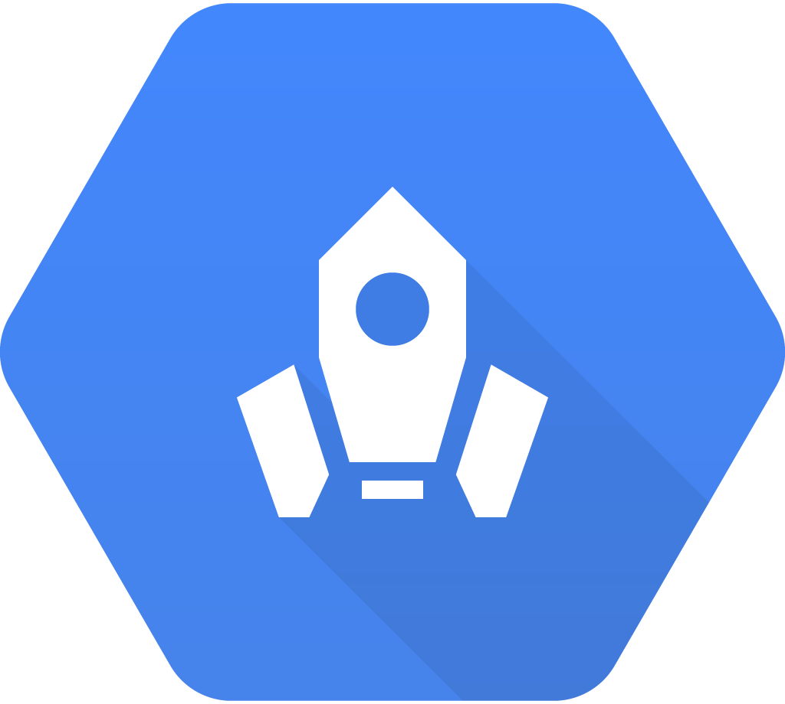
Virtual machines
Cloud Launcher
Prebuilt software images
MongoDB, etc
Single systems
Groups of systems
Administer instance templates
Apply changes to whole group
Still need to administer the machine
Notes:
Cloud Launcher is a collection of premade software images used for quickly getting known, popular software packages up and running on a VM. Need a machine running Mongo? Go to Cloud Launcher and just create a launcher instance. We don’t manage the software, you still have to administer the machine just like you would any other VM.

Slide 15
Compute Engine demo
Kick the tires and launch a few VMs
Notes:
Determine if you have time. If you do:
VM screen
Create VM
SSH into it.

Slide 16
Containers
Notes:
How many people are playing with containers today?
How many are using in production?
How many made the mistake of saying the word “Docker” out loud and had a whole conference spring up around them?
If needed explain containers.

Slide 17
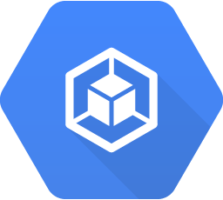
Containers
Container Engine
Managed Kubernetes
Notes:
For containers our first option is Container Engine. Container engine is hosted Kubernetes.

Slide 18
Kuber-what-es?

Slide 19
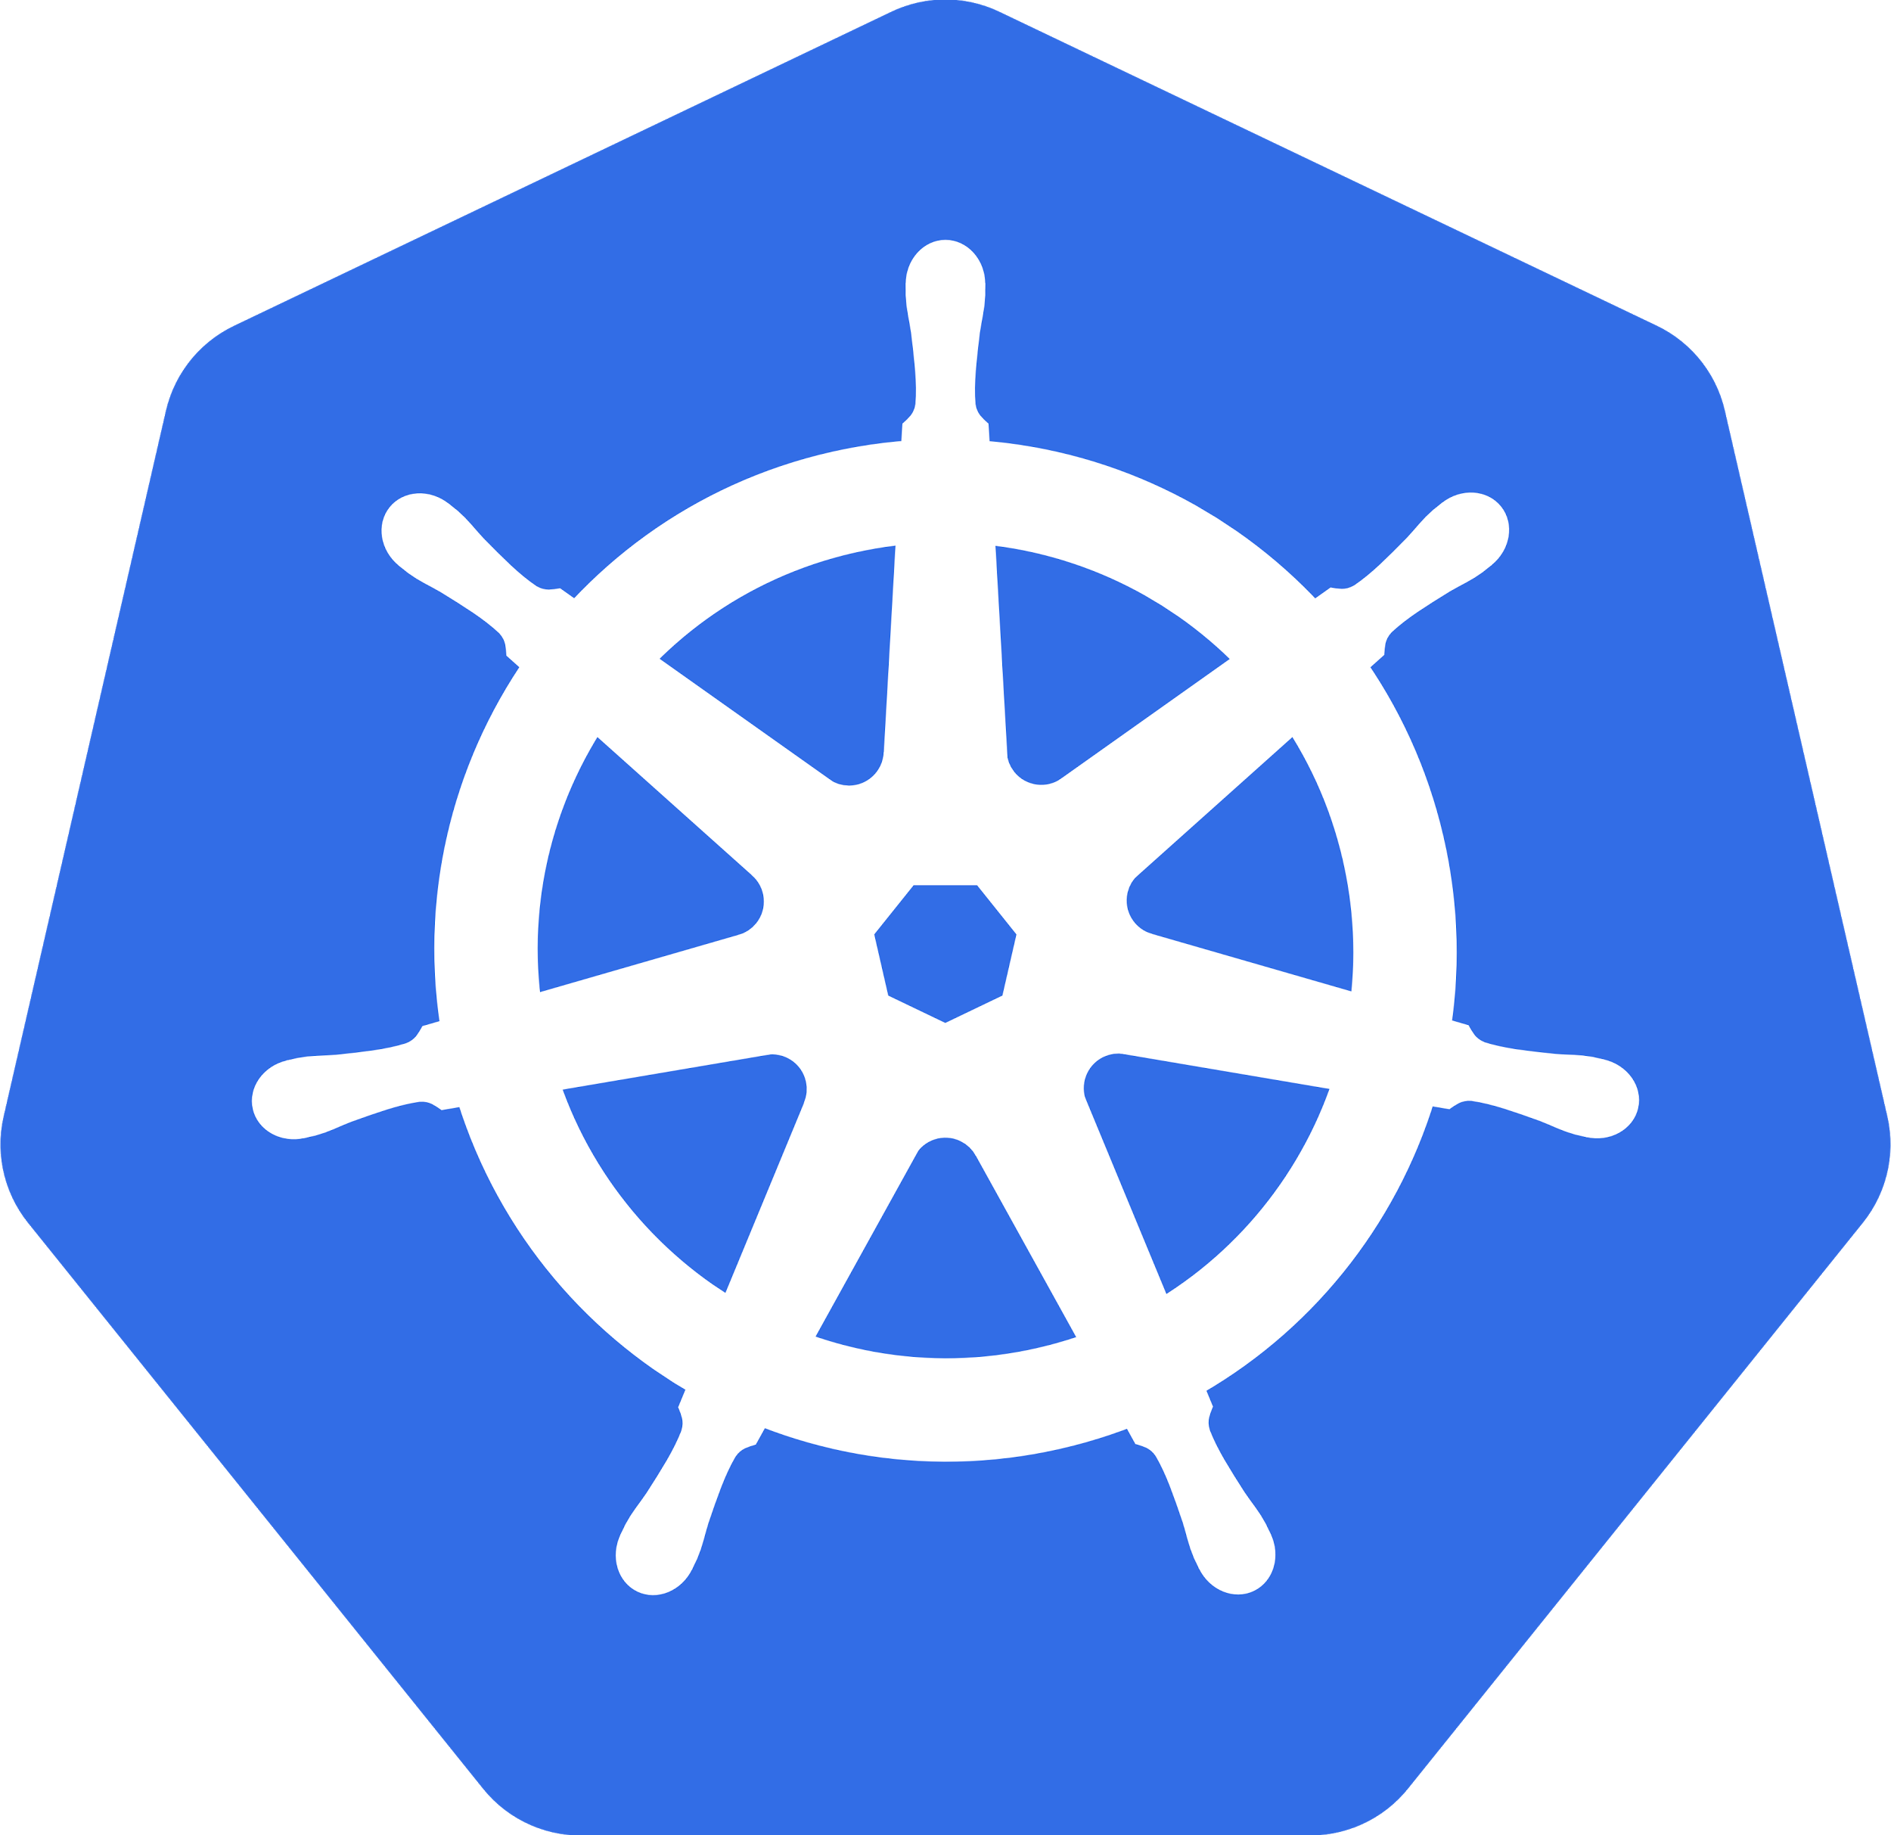


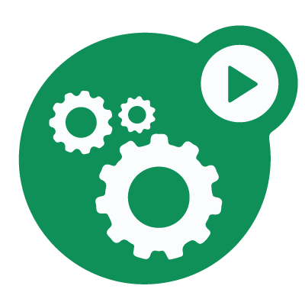
Kubernetes
Container Orchestration System
Cloud OS
Keeps processes running and prevents collisions
Allows for running a large number of containers in production
Organizing them into workloads
Microservices
Scheduled jobs
Batch jobs
Configuration driven
Frontend 10.0.0.1
Public 130.91.x.x1
API 10.0.0.2
Public 130.91.x.x2
Data 10.0.0.3
Notes:
Kubernetes is what we call a Container Orchestration system. You can call it Cloud Operating System if it helps you wrap your mind around it. If containers a processors, Kubernetes keeps them all running and not colliding. It allows you to run large number of redundant containers, and bundle those containers up into workloads - whether thats a set of scheduled jobs, or a microservice, whatever. . And it makes building complex workloads pretty easy.
You tell Kubernetes (in a configuration file equivalent) that I want single instance of a private database service, 4 redundant instances of a public api service, and 3 redundant instances of a public front end service and kubernetes just makes it happen. And one of the best things here, I can keep filling up these machines with containers, until I run out of resources - helping you get the most out of the hardware.
And it will keep that number running. If one segfaults or something, it will just spin up another copy of the container.

Slide 20






Kubernetes
Still need to:
Build out nodes
Install Kubernetes
Setup network
Add LBs
Setup DNS
Configure logging and monitoring
Persistent disks
Kubernetes upgrades
OS upgrades
DNS Server
Service Discovery
Logging
!
Monitoring
Notes:
From a system side, there’s a bit to setup to run Kubernetes.
You have to build out a master and nodes.
Then you have to install Kubernetes services on the machines.
Then you have to setup a network.
You’ll have to add Load balancers and deal with ingress
Then you have to setup DNS and service discovery.
Once that’s done you’ll probably want to setup logging and you might as well go for monitoring too.
And you probably want persistent disks that live outside of your containers. Cause ephemeral for user data is not, ya know, something anyone wants.
That’s not to mention patching Kubernetes
And patching the OS on the nodes.
That’s a fair amount of work.

Slide 21
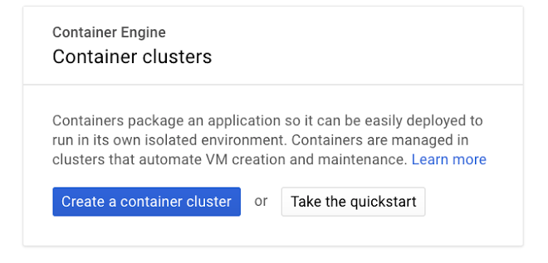


DNS Server
Service Discovery
Logging
!
Monitoring
Notes:
Or just push this button.
And we’ll spin all that up. And take care of updates, and upgrading hosts. GKE also handles autoscaling.

Slide 22
Container Engine demo
Launch a few services
Notes:
Again, do I have time.
But if so, launch 6 container systems at once.
Don’t launch them, just show them running.

Slide 23
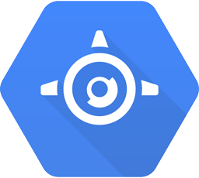
Containers
Container Engine
Managed Kubernetes (Containers as a service)
Smart defaults for
Monitoring
Logging
DNS
Service Discovery
Auto scaling
App Engine flexible environment
Custom Runtime
Uses Docker under the covers
Bring your own Dockerfile (if you want to)
Autoscaling
Given one endpoint per service
Notes:
So that is the short story of explaining Container Engine. It’s managed Kubernetes. It’s containers as a service. It’s got smart defaults setup for monitoring, logging, dns etc. It’s all setup for you. You also gain the ability to have systems that auto scale. Autoscaling is available for containers on Kubernetes, but not by default for the nodes that run it. With GKE you are running Kubernetes on a managed Compute Engine setup, and one of the benefits of that is autoscaling of GCE machines in a managed group.
Now we get to App Engine flexible environment. App Engine can do a lot of things, I’m going to be talking about it in serverless as well. But flexible environment is a feature that uses Docker under the covers to run your application. Now you don’t ever have to mess with Docker if you don’t want to on flexible runtime, if you just upload your code in a language that we have support for, then we’ll just run it and Docker never surfaces.
BUT if you WANT to play with Docker, flexible environment has a setting called Custom runtime that allows you to run any Dockerfile you want. This will give you a running instance of your container, along with the ability for your containerized service to scale out as the number of requests grows. It will also give you a single url to host your service at. You don’t have to setup a hostname and all that if you don’t want to. (you of course can do so if you wish)

Slide 24
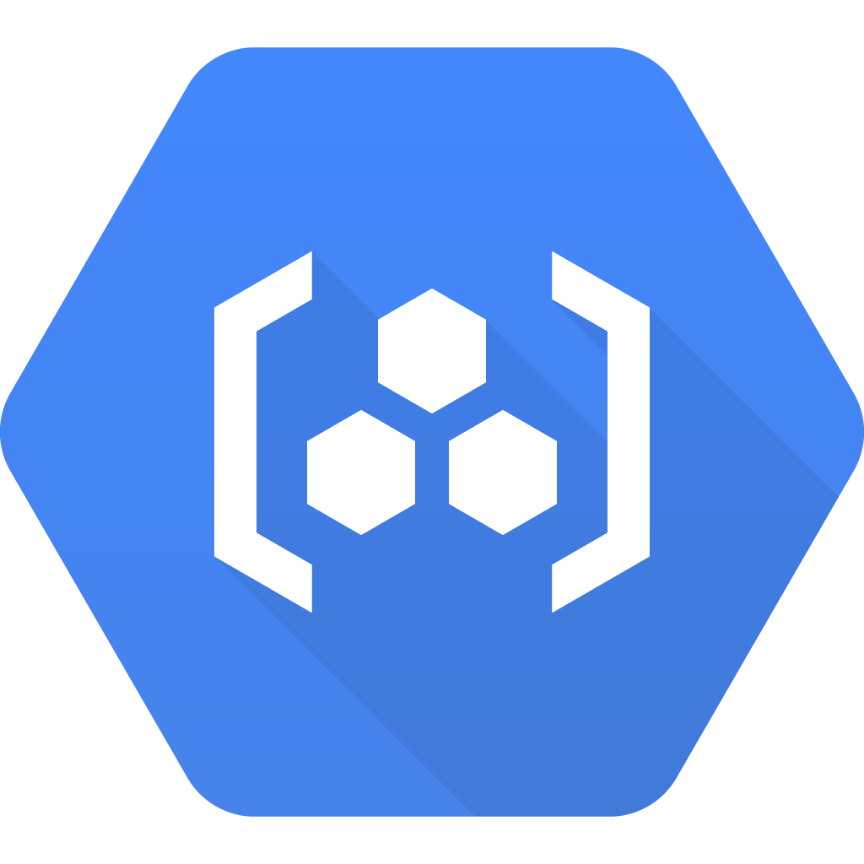
Containers
Container Registry
Container image storage
Works with
GKE (Container Engine)
App Engine flexible
Docker
Container Builder
Container building as service
Build container in the cloud
Integrates with Container Registry
Integrated with build processes
Notes:
There is also Container Registry. You can use it to serve up Docker images for either Container Engine or App Engine flexible environment. You can also use it to serve images down to develop locally on Docker. The big win here is that Container Registry allows you to make these private and authenticate using your Google Cloud credentials.
Another Container tool - that we just added today, is Container Builder. It’s designed to offload the process of building container images to the cloud instead of locally. There are a few major benefits to this. You don’t have to move image files across the network. And this can all be built in and integrated to your CI systems.

Slide 25
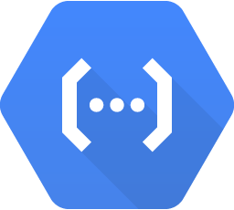
Serverless
App Engine flexible runtime
Languages
Java 8 / Servlet 3.1 / Jetty 9
Python 2.7 & 3.5
Node.js,
Ruby, PHP, GO
Uses Docker underneath
Open capabilities
App Engine standard runtime
Languages
Python 2.7
Java 7
PHP 5.5
Go
Does not use Docker underneath
Constrained capabilities
Incredibly rapid scale
Cloud functions (beta)
Javascript / Node.js
Single purpose
Event-driven trigger
Ex: Email function
Notes:
Okay now to serverless.
So we have two flavors of App Engine, flexible and standard. Flexible under the covers as I stated before uses containers. But you don’t have to use containers. If you use one of these languages you don’t ever have to interact with a Dockerfile. You get a premade docker image with all of the Cloud SDK’s already built and configured. You just upload code. If you want to extend the Dockerfile and add extra software, you certainly can.
Now for standard. Standard does not use Docker under the covers, and it is very locked down. You cannot use anything other than code written in a supported language. For example if you use PHP, you can use PHP frameworks written in PHP, but you cannot use an extension written in C. In return you get the ability to scale very fast. Like in milliseconds. You also get the ability to scale down to zero running instances. So if you have very spiky load conditions this can help you meet user demand.
Last but not least is Cloud Functions. The basic unit of app engine is an application, for Cloud Functions it’s obviously a function. You write a small function that does one thing, and trigger it to run based on an event. That event can be triggered by a number of types of events, and it runs the function. Canonical example is adding an email notification to some event. Why write up a whole app to just do what is the equivalent one function. Now you don’t have to.

Slide 26
Networking
Connecting things

Slide 27



Networking
Connection
Security
Availability
Notes:
Networking tends be about connecting resources, locking those connections down, and making sure that those resources are as accessible as possible.

Slide 28
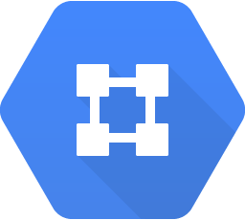
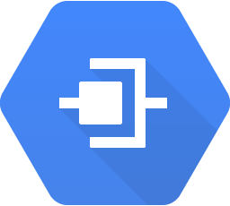
Connection
Cloud Virtual Network
Create custom private cloud networks
Set up custom routes to your other non-Google locations
Google Cloud VPN securely connects your existing network to your Google Cloud Platform (GCP) network through an IPsec VPN connection.
Cloud Interconnect
Create a dedicated connection to Google
Direct Peer to one of our local or regional Points of Presence
Cloud Interconnect enables you to connect your infrastructure to Google, via enterprise-grade connections to Google's network edge.
The connections are offered by Cloud Interconnect service providers.
Notes:
Cloud virtual network is a private network space that you can setup for you resources. You can connect machines and setup custom routes to non Google sites.
Cloud interconnect is about peering. You basically have a direct connection to our network for communication to your on prem resources.
Research:
https://cloud.google.com/interconnect/docs
https://cloud.google.com/compute/docs/vpn/overview

Slide 29


Security
VPN
Gateway to Gateway Only
Can be used to connect to any IPSEC compliant gateway
Firewall
Set up rules
Apply rules to tags
Apply tags to hosts
Notes:
https://cloud.google.com/compute/docs/vpn/creating-vpns
https://cloud.google.com/compute/docs/networking#firewalls
VPNs at GCP are for connecting to VPN gateways, they’re not for users, they are for machines and networks. With that limitation in mind, you can use them to setup a secure tunnel using any IPSEC gateway. We have documentation for connecting to various VPN gateways in use at several other cloud providers.
Firewall is pretty stright forward: create rules (punch open connections for ports) collect those rules in tags, and apply tags to hosts.

Slide 30
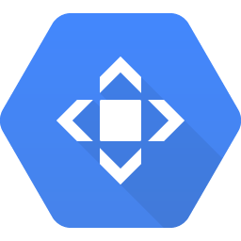
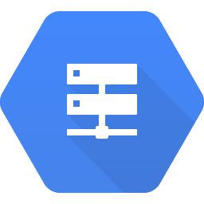
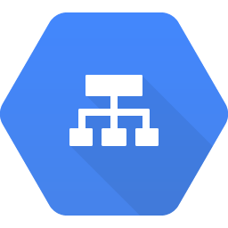
Availability
CDN
Basic Content Delivery Network
Activate through our load balancers
Ability to cache content
Uses HTTP headers to determine cacheability
DNS
Manage DNS on Google’s network
SLA promises 100% availability of our Authoritative Name Servers
Load Balancers
HTTP
SSL
Internal
Network
Notes:
https://cloud.google.com/cdn/docs/overview
https://cloud.google.com/dns/overview
Cloud CDN is a basic CDN with the ability to cache content, and invalidate it at the edges of our network. You setup them up through our load balancers, and they use http headers to determine cacheability. If you need more funcationality than we offer directly, we have partners like Fastly, that can help.
DNS is pretty interesting. I mean it’s not, it’s DNS, but we offer 100% SLA on the availability of our Authoritative Name servers. Very cool.
We have four flavors of LBs.

Slide 31
Non-managed security solutions
Compute Engine
Build by hand
Cloud Launcher
Prebuilt solutions for:
Barracuda
Brocade
Cloudflare
more...
Notes:
Once again if you want something else you can build it.
In fact we quite a few products available from several known names in this space all in Cloud launcher

Slide 32
Storage
Keeping things
Notes:
Now moving on to storage.

Slide 33
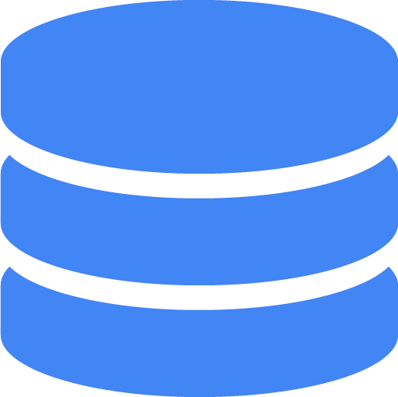



Storage
Files
Databases
Big data
https://cloud.google.com/storage-options/
Notes:
I see storage breaking down along three lines. You might call it File storage - media, documents, archives, and other forms of mostly binary storage. We like to call it blob storage. Why?
Cause if you stop monitoring it, it will devour you completely….
No cause, file, you think file systems, and mounting disks, and a whole bunch of stuff you can’t do with the tools I’m talking about.
We have persistent disks, you usually use them with computing resources. But here I’m talking about buckets. Not actual buckets, but you know big storage buckets in the sky.
Application data - data that is generated by or used by users in some sort of application. And then Big Data, which involves storage, but also tools for analyzing the massive amount of things you store. Basically, big data usually starts out over here, but then you stop monitoring it…
And it devours you completely.
No it just grows to a point where it is there is knowledge to be gleaned but you’re going to need a bigger boat. And better tools. And less metaphor mixing.

Slide 34
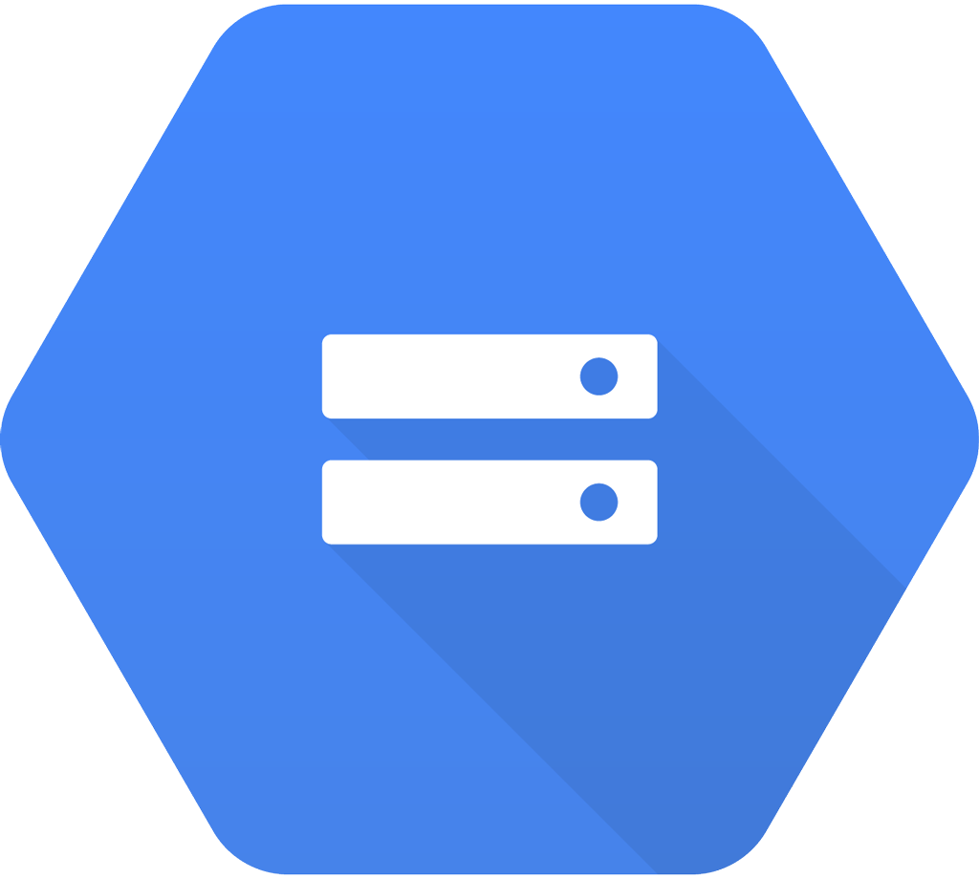
File storage
Cloud Storage
Multiples ways to interface with it
Browser, gsutil, API
Several types
Multi-regional
Regional
Nearline
Coldline
Create a storage bucket, choose type
Notes:
So file or blob storage is pretty straightforward, we have one central source for blob storage for GCP - Cloud Storage. There are several ways of interacting with it. Through the browser, via gsutil tool, or using the Cloud API. No matter which type you are using the way you access is completely the same.
Also you have the ability to make any file you share public.
The types are Multi-regional, Regional, Nearline and Coldline. You pick one of those types when you create a bucket, and that’s it. Let’s explain the difference between the types.

Slide 35


File storage
Public content
Processed data
Long term storage
Notes:
First a chart of three things, because clearly I like making them.
So breaking down storage needs here, I see a need for publicly available data, which is things like web content, gaming resources, or anything you want to make sure can be accessed publically thereforee needs to be in many places around the global to ensure low latency.
Then there is private data, type you would proccess, but not necessarily share. You’d want the data close to the machines that will process it, but you don’t need it to be global.
Finally there is data that you would rather not have to see again. Compliance data, long term backups that you don’t use unless things are going to complete crap. I think long term storage.

Slide 36
 | Public | Processed | Long Term Storage
Characteristics | 99.95% availability Geo-redundant | 99.9% availability Data stored in a narrow geographic region | 99.0% availability 30-day minimum storage duration | 99.0% availability 90-day minimum storage duration
Uses Cases | Frequently accessed World Audience Website content Streaming video Gaming Mobile | Accessed by your system But not by your customers Big Data sets for processing | Backup Long tail multimedia | Disaster recovery Compliance archives
Storage Cost GB/month | $.026 | $.02 | $.01 | $.007
Retrieval Cost GB |  |  | $.01 | $.05
Storage Type | Multi-region | Regional | Nearline | Coldline
Notes:
So applying that to our Cloud Storage…
Then I just read the chart as it is revealed.

Slide 37
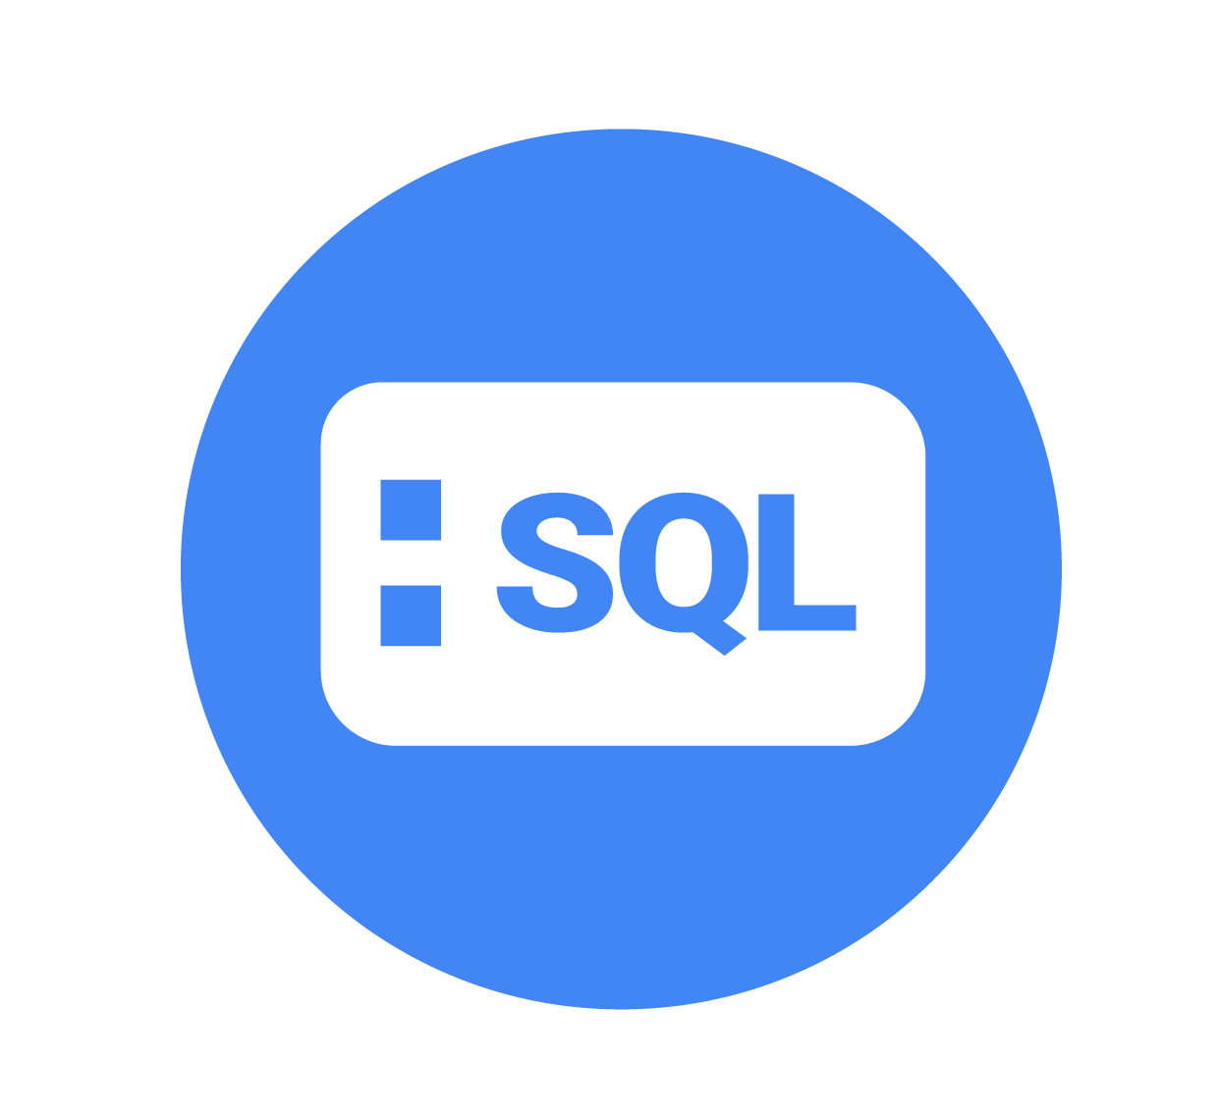
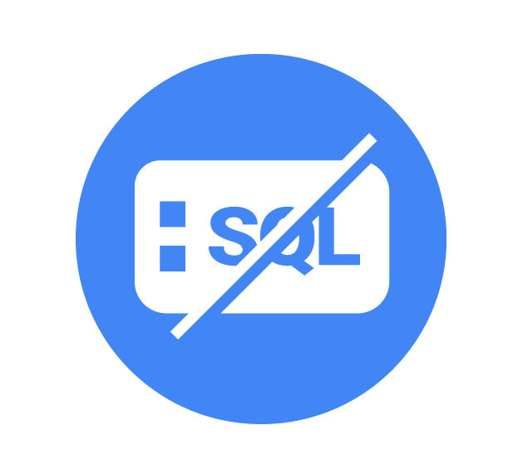
Application data
SQL
NoSQL
Notes:
We have our two contenders for the hearts and minds of application developers everywhere: SQL and NoSQL. As everyone knows NoSQL is famous for being web scale, because only NoSQL can be webscale. And SQL is great for turning incomprehensible spreadsheets that run the whole business into something that we can look ourselves in the eyes and use.
Joking aside, they both have their place and like many other topics in this talk, you could dedicate a whole talk or conference to the subject.

Slide 38
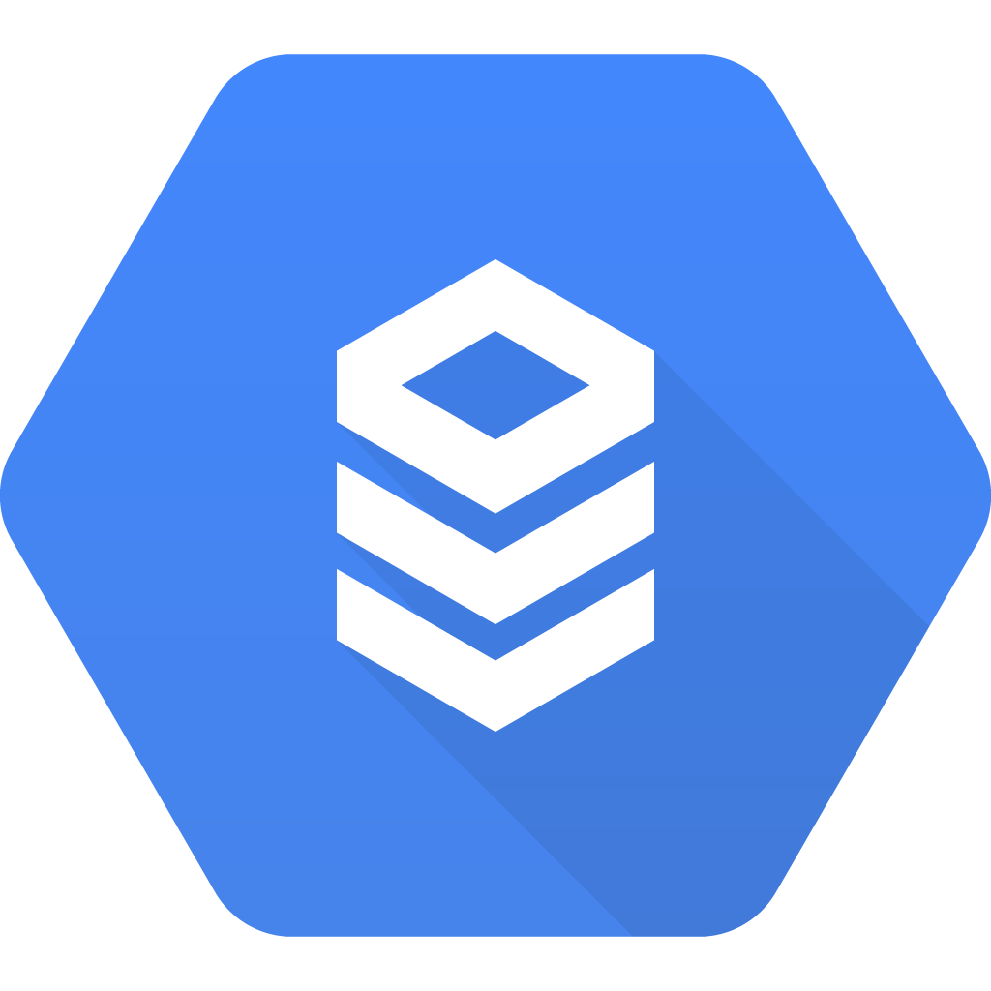
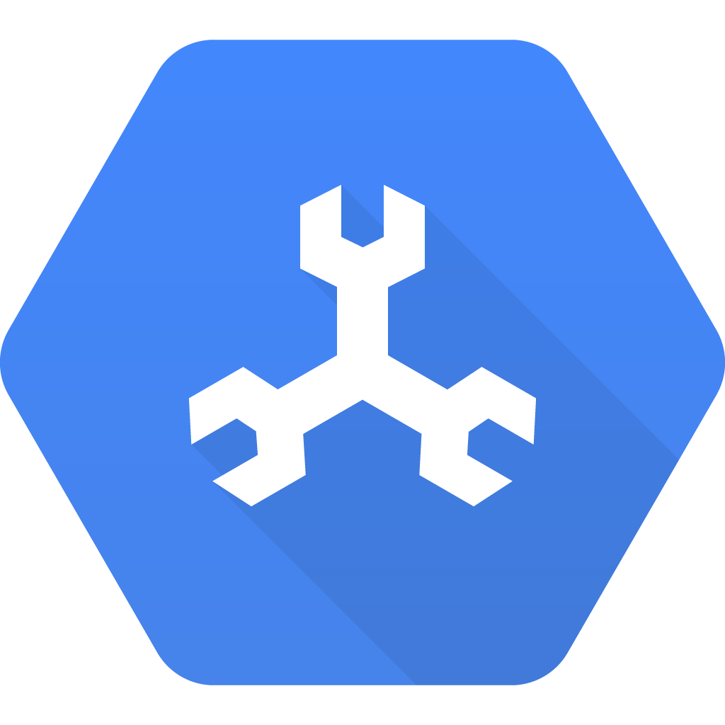
SQL
Cloud SQL
Traditional SQL Server
Vertically scalable
Managed backups
Easy to setup replicas
Types
MySQL
Postgres (new)
Cloud Spanner
Structured data
Highly available
Strongly consistent
CAP theorem says impossible
Globally distributed
Horizontally scalable
Notes:
Let’s start with SQL. First we have the aptly named “Cloud SQL” It is a traditional RDBMS. It’s so traditional that you would call it MySQL. You get managed backups, and really easy to setup replication. You can power SQL with a few proc/memory configs that are common for Compute Engine. You cna keep them private or make them public, and have a pretty straight forward way of opening up access.
Also I said MySQL, but we also have Postgres, which have recently added to the mix. For those of you who prefer Postres, heres you go.
You probably heard an announcement about Cloud Spanner in a keynote. We’re really excited about this. Its a structured data store that is highly available, so easy to make globally redundant and available, but is also highly consistent. Those of you who have been paying attention you know that the CAP theorem says this is impossible. So the guy invented CAP theorem, who works for us now, is all like “No, we’re cool.”
Short story, It’s not really all three, it’s actually CP, but our internal network makes failures so rare that if you squint, it’s pretty close to CAP.
So right now the all data editing, Inserting, updating, deleting, is done through an API. But you can do complex SELECT statements in SQL.
It’s important to level with you and let you know, this is really awesome tech, that isn’t for everyone. I highly reccomend you take a look at the costs assoicated with your setup, and figure out if you need this combo of Conisistentcy and availablility.

Slide 39
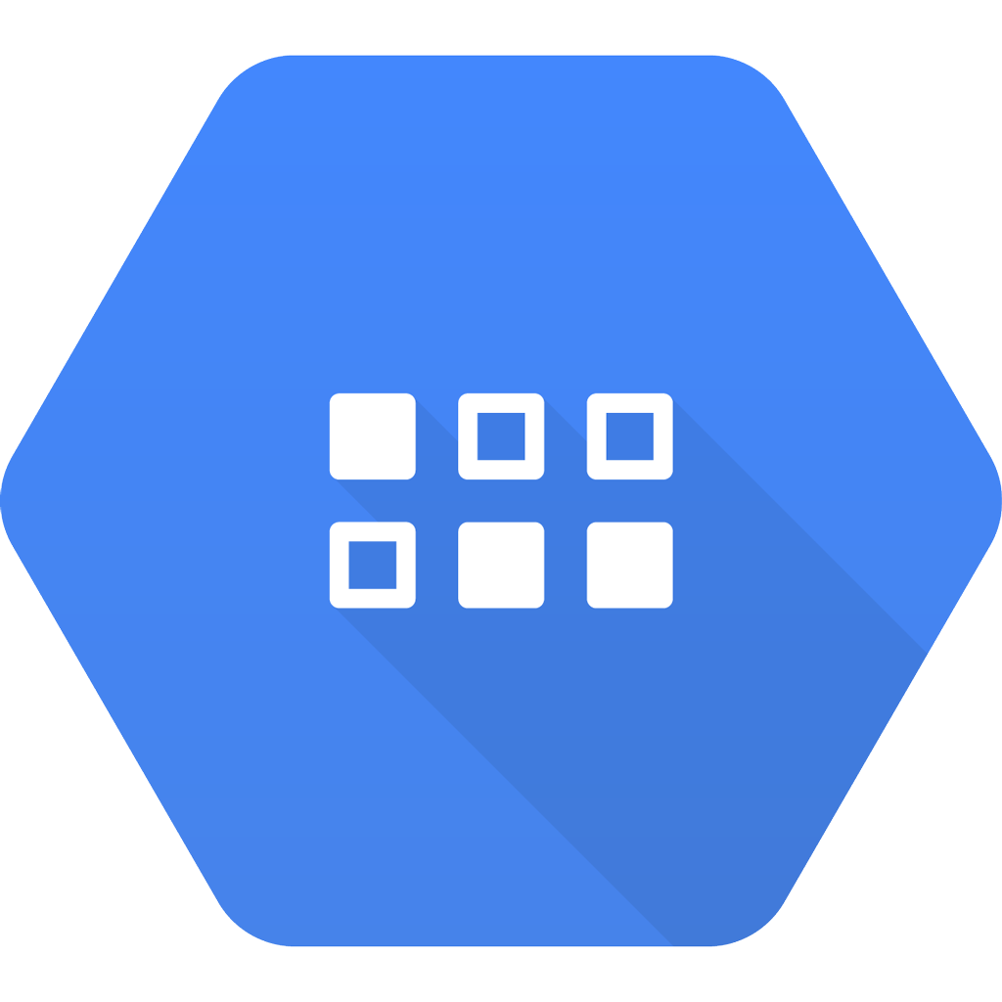
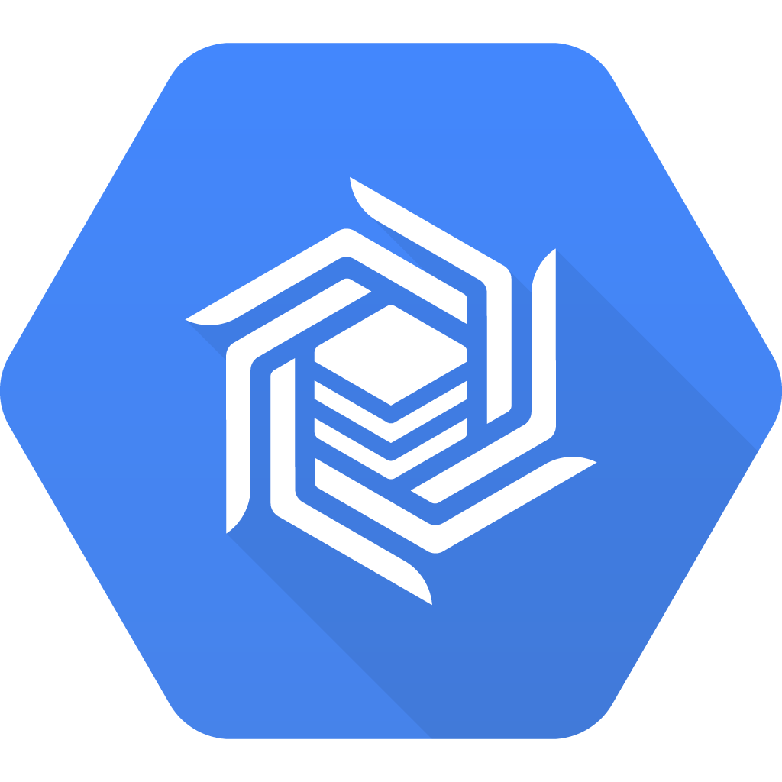
NoSQL
Cloud Datastore
Document based
Indexable
Distributed
Giant semi-structured data sets
Examples:
Product Catalogs, Real-time Inventory
Optimized to serve high-value transactional data to applications
Cloud Bigtable
Columnar
Low latency
Hbase API compatible
Needs scale to be cost effective (> 1TB)
Powers Google Maps, Analytics, Search, etc.
Does not replicate across regions
Optimized for high volumes of data and analytics
Notes:
So moving onto NoSQL we have two solutions.
Datastore, standard description.
The next one is Cloud Bigtable. So years and years ago (2006), we released a paper on one of our datastores, called Big Table. It inspired people to create a data storage tool caused Hbase. Then we made our version of Big Table accessible as a Cloud Product. And since Hbase caught on, we made sure there is a Hbase compatible API.
It’s a columnar database that can handle tremendous amounts of data. It’s a… big table. We don’t see it used as a back to Applications that much, but it does provide very low latency so some have used it to back an application.
But keep in mind that the entry costs make it not a good choice unless you are trying to manage more than a terabyte of data.

Slide 40
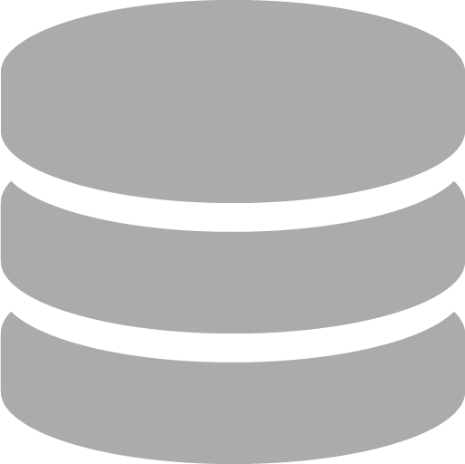

Storage
Files
Databases
Big data
Notes:
I see storage breaking down along three lines. You might call it File storage - media, documents, archives, and other forms of mostly binary storage. We like to call it blob storage. Why?
Cause if you stop monitoring it, it will devour you completely….
No cause, file, you think file systems, and mounting disks, and a whole bunch of stuff you can’t do with the tools I’m talking about.
We have persistent disks, you usually use them with computing resources. But here I’m talking about buckets. Not actual buckets, but you know big storage buckets in the sky.
Application data - data that is generated by or used by users in some sort of applilcation. And then Big Data, which involves storage, but also tools for analyzing the massive amount of things you store. Basically, big data usually starts out over here, but then you stop monitoring it…
And it devours you completely.
No it just grows to a point where it is there is knowledge to be gleaned but you’re going to need a bigger boat. And better tools. And less metaphor mixing.

Slide 41
Where do you store
Big Data?

Slide 42

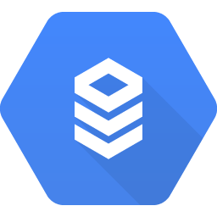

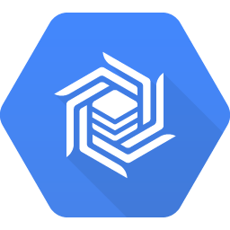
Cloud Storage
Cloud SQL
Cloud Datastore
Cloud Spanner
Cloud Bigtable

Slide 43
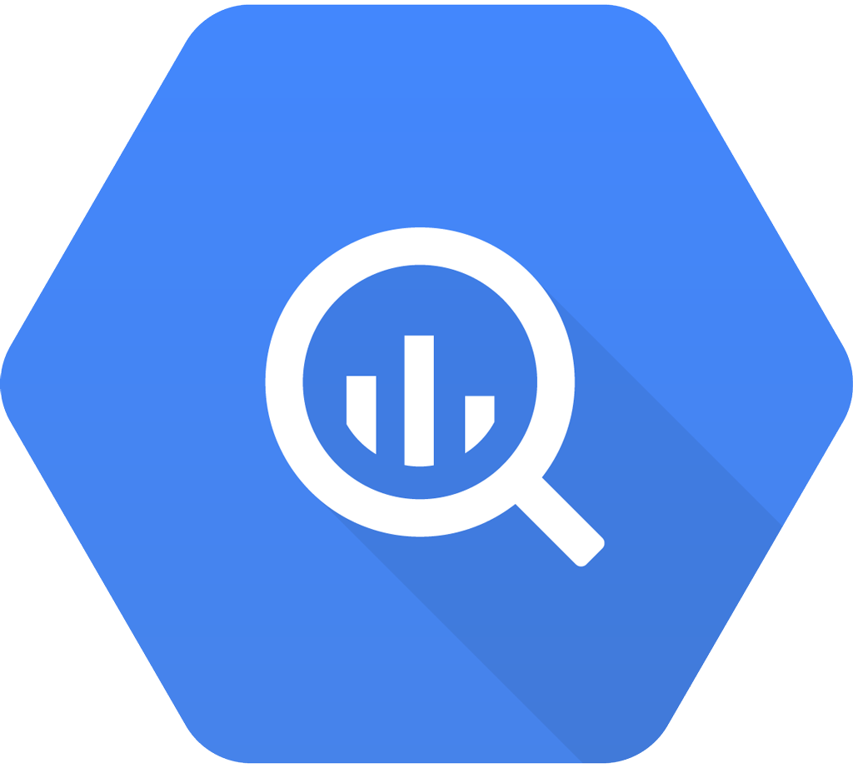
Big data
BigQuery
Google BigQuery is an enterprise data warehouse
Enables super-fast SQL queries using the processing power of Google's infrastructure.
Access it through a web UI, command-line tool, REST API or SDK.
Use 3rd party tools to analyze, visualize and load the data.
Notes:
Speaking of analyze, let’s talk about BigQuery. Big Query is another one of those sorta like magic tools that I didn’t discover until someone showed me how cool it was. So when you do a normal big data job, you spin up as many resource as you can, run your big data analysis, and your speed of results is pretty much a product of how many resources you throw at it. Well BigQuery has Google’s infastructure at its disposal, so your jobs run pretty much as fast as it is possible. You will get back in seconds what you may have gotten back in hours from other tools. And you can use SQL for your queries. So you don’t have to be a data scientist to do big data queries.
BigQuery is designed for analytical workloads only. It has no indices at all. Every SQL query you run is a full table scan. Until very recently, you could not mutate data in it and it is still not the main use case. BigQuery is columnar.
BigTable is designed for very high throughput production environments (reads/writes). It's a key-value store. Its querying capabilities are very limited though (retrieve by key and not much else)
For ingesting time series, I would prefer BigQuery (no mutations involved) unless you have extreme performance requirements.

Slide 44
BigQuery demo
Quick demo showing BigQuery
Notes:
IF we have time.

Slide 45
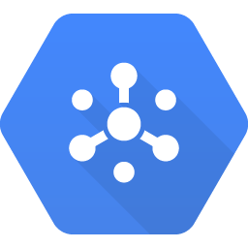
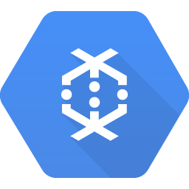
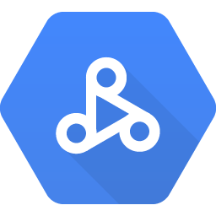
Big data - not storage
Pub/Sub
Messaging Bus
Many to many
Can easily handle 1 million messages per second
Dataflow
Managed service for data analysis
Apache Beam
ETL, batch computation, and continuous computation
Work scheduling
Dataproc
Managed Spark and Hadoop
With Autoscaling
Notes:
So while we are talking about BigQuery and it’s role as both a storage product and an analysis tool, we should bring up some other tools on the big data side.
Pub/Sub is our messaging bus. It can handle many to many connections in a publisher and subscriber model. It can handle very high throughputs. And basically, if you don’t need to write more than 1 million messages per seconds, we don’t need to do anything special to help you run.
Dataflow is a managed service for data analysis. If you are familiar with Apache Beam - this is managed Apache Beam. If you aren’t. It basically allows you to write multi step data pipelines with custom transformations and data manipulation at various points along the flow.
Dataproc is managed spark and hadoop.

Slide 46

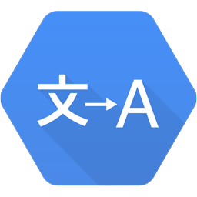
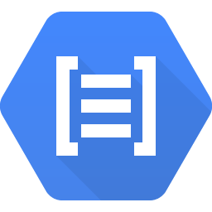
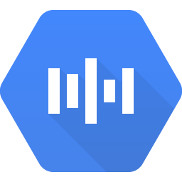

Cloud Datastore
Cloud Dataflow
Cloud SQL
Compute Engine
Cloud Pub/Sub
Cloud Spanner
App Engine
Cloud Storage
Cloud Bigtable
Container Engine
BigQuery
Cloud Functions
Translation API
Natural Language API
Speech API
Vision API
Notes:
So here’s where I need to point out that all of Clouds various products and services have API’s for communicating to them. But are trying to figure out how to communicate between them, the answer is usually Pub/Sub or Cloud Storage.
For example if you want to analyze an image using Cloud Vision API from an App Engine App - you upload it to Cloud Storage from App Engine, then tell Cloud Vision the location in Storage to analyze.
Or if you want to email someone every time someone uploads to Cloud Storage, you setup Cloud Storage to send Object notifications to a PubSub Channel that a Cloud function is listening to.
With these two tools you can pretty much easily intergrate any combo of GCP tools.

Slide 47
What if I need something you don’t offer?

Slide 48
Non-managed storage solutions
Compute Engine
Build by hand
Cloud Launcher
Prebuilt solutions for:
Cassandra
Redis
Mongo
CouchDB
more...
Notes:
If we don’t have something you need. There is nothing stopping you from building your own solution using GCE. We welcome you to do so.
In fact in Cloud Launcher we have prebuilt solutions for a few storage solutions like Redis and mongo just to name a few.
Yeah, you don’t get a mangaged solution out of it, but it should block you at all.

Slide 49
Administration
Operations

Slide 50


Administration
Reporting
Security
Configuration
Notes:
I think Operations breaks down to three needs.
The need to know what is going on, or reporting.
The need to make sure people are only accessing what they should, security.
And the need to make their will real on systems - configuration.

Slide 51
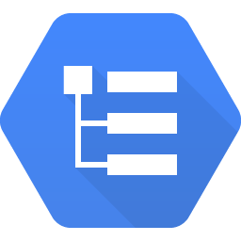
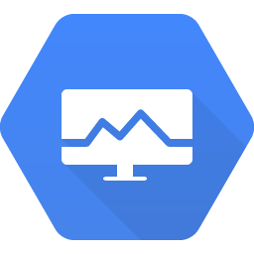
Reporting
Stackdriver Logging
Cross Cloud Logging
GCP
AWS
On Prem possible
SDKs
APIs
Stackdriver Monitoring
Cross Cloud Monitoring
GCP
AWS
Alerts based off
Logs
Uptime checks
Built in or Custom Metrics
Notes:
Logs aren’t terribly exciting. But stackdriver logs are cross cloud. You cna monitor AWS and/or GCP machines in stackdriver.
Most parts of GCP log automatically to Stackdriver logs. And you can setup streaming into BigQuery to do log analysis.
Also cross cloud, monitoring allows you to setup alerts based on logs, or uptime or even custom metrics.
https://cloud.google.com/monitoring/docs/concepts
https://cloud.google.com/logging/docs/concepts

Slide 52

Data Studio
Data Studio (beta)
Allows user to create Dashboards
Creates Reports
Transforms data
Visualizes data
Connect data from Cloud SQL, Big Query, etc

Slide 53
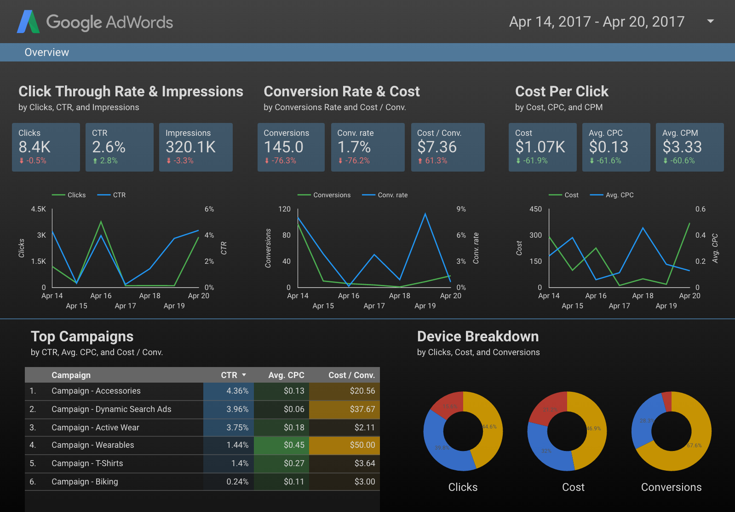
Data Studio

Slide 54
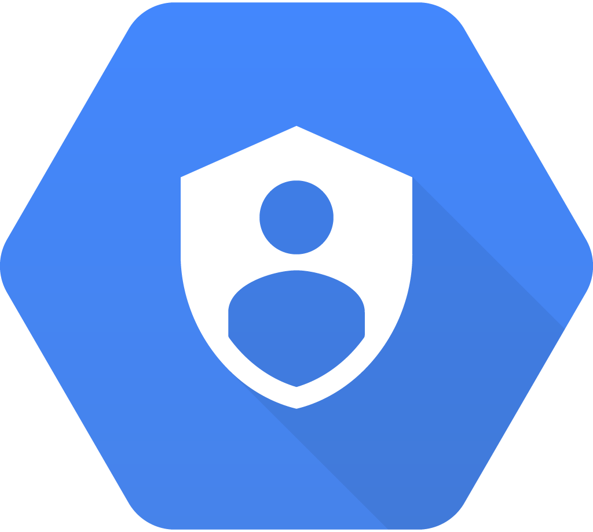
Security
Cloud IAM
Allow for group of resources
Role based permissions
Fine grained controls
Vary from product to product
Notes:
Cloud Identity and Access Management is our users and permissions control panel. It’s pretty straight forward. You can create organizations to hold your projects. Then you create roles to contain privledges, and add users to those roles.

Slide 55

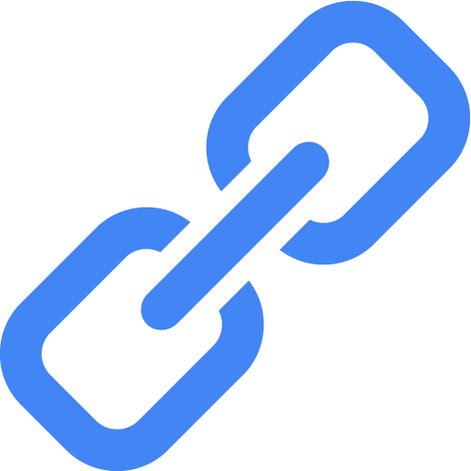
Configuration
CLI
gcloud
gsutil
API
SDK for most languages
REST endpoints
Functional equivalent to gcloud
Deployment Manager
Repeatable Complex deployments
Configs
Templates
Disk Images
Network setup
more
Notes:
All config tasks can ben done through the CLI. gcloud is this CLI. It’s pretty straght forward
Get a list of all compute vms: gcloud compute instances list
Get the config for a GKE cluster: gcloud container cluster describe
Pretty straight forward.
But you may want to script some of what you do on the cloud, you may want to build apps for managing them. Everything you can do in gcloud is available via the CLoud APIs, and there are SDKs for many languages.
Finally if you have a complex setup that you need to repeat, you can use Deploymnet manager to put them together. They’re yaml based systems that allow you to repeat systems, configs, disk, disk images, netowrk setups on more. It’s used as part of cloud launcher.
https://cloud.google.com/cdn/docs/overview
https://cloud.google.com/dns/overview

Slide 56
Development
Code
Notes:
Now an area close to my own heart. Development. How do developers do what they need to do on our platform.

Slide 57

Development
Coding
Reporting
Services
Notes:
So developers need to code. They also need reporting, but of a different type than administrators, and they could use services that take care of particularly difficult parts of their job.

Slide 58

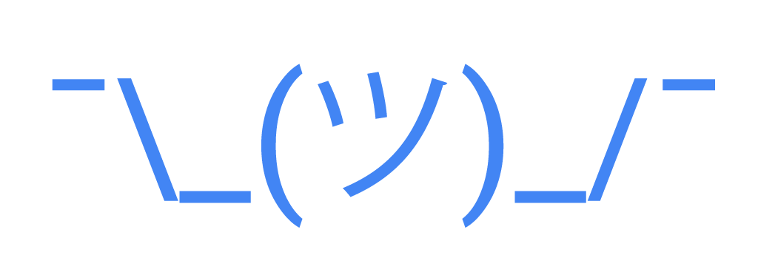
Development
SDK
gcloud
gsutil
Appcfg.py
Client SDK
Plugins
IntelliJ
Android Studio
Powershell
Visual Studio
Eclipse
Other
Cloud Source Repository
Hosted GIT
Ties into Debugging/Trace features
Notes:
So first you need the SDK. This is the way to do anything on GCP. gcloud is a unified interface for most of your needs on GCP. But if you need to deal with file operations on storage, gsutil comes in handy. And Appcfg.py is needed for a few app engine operations.
We have plugins that extend most major IDEs for use with GCP.
I ran out of symbols. We have Cloud Source repository which is hosted git. But it also integrates with Debugging which I will talk about in a bit, to make certain things a little easier when using it.

Slide 59
Development
Reporting
Notes:
So developers neeed to code. They also need reporting, but of a different type than administrators, and they could use services that take care of particularly difficult parts of their job.

Slide 60
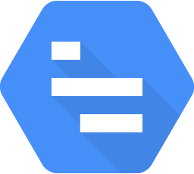
Tracing
Stackdriver Trace
Automatic
App Engine
Load Balancers
Enabled through an SDK
Java
Node.js
Go
Ruby
Zipkin
Links to logs
Notes:
Stackdriver trace is a great way to see what going on under the covers in your application in a way that really helps you performance tune.
It’s automtically available for App Engine and Load balancers
And it can be enabled via an SDK for other tools or products.
One of the things I love, is that it links straigh through to the logs, so you can get a great view of what is happening on your system.

Slide 61
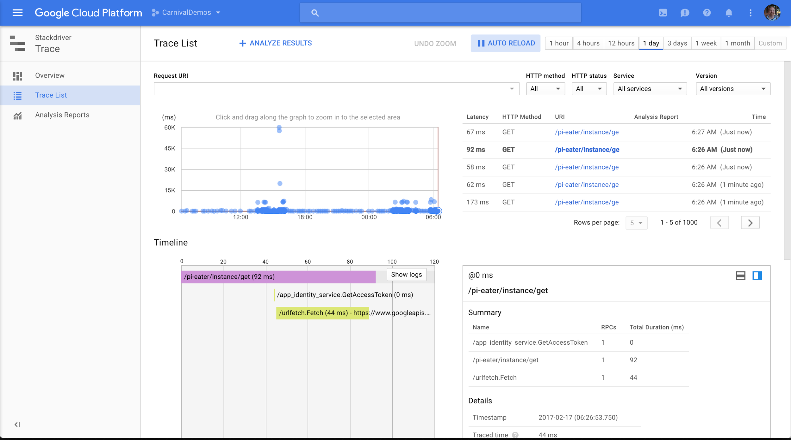
Notes:
This is tracing for one of the apps out in the sandbox. The Pi Cruncher. I was trying to track down a peformance issue. It wasn’t here, but i could see that there were odd outliers in execution time for this action. Help me track down the issue.

Slide 62
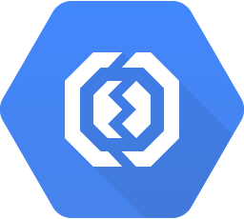
Error Reporting
Stackdriver Error Reporting
Aggregate
Logs or API
Alerts
Notes:
Error Reporting ia an agregation of errors, that you setup either by using stack driver logging or by calling an API.
All in once place, you can see when you are causing issues, and see the complete error message in once place.

Slide 63
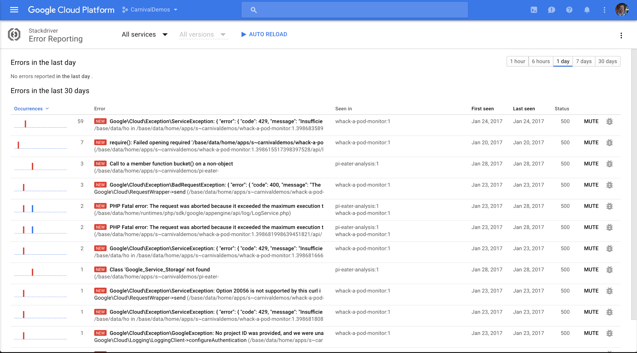
Notes:
This is an error report from the same pi cruncher application I was talking about before.
I had a test rig setup that just builds and times the build of VMs. But it was dying everyonce in awhile. Couldn’t figure out why. These error logs pointed me to two issues:
1 That I was running out of quota. (who knew that repeatedly building machines would do that.)
2. Premptible VM’s were being preempted.

Slide 64
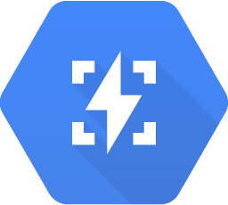
Debugging
Stackdriver Debugging
App Engine
Java
Python
Node.js
Ruby
Compute Engine
Java
Python
Go
Notes:
Debugging allows step debugging for a few enviromments on App Engine and Compute Engine.

Slide 65
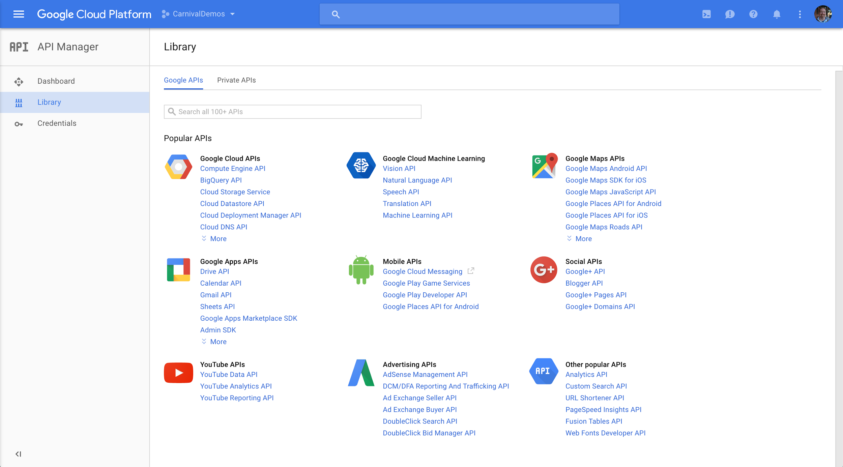
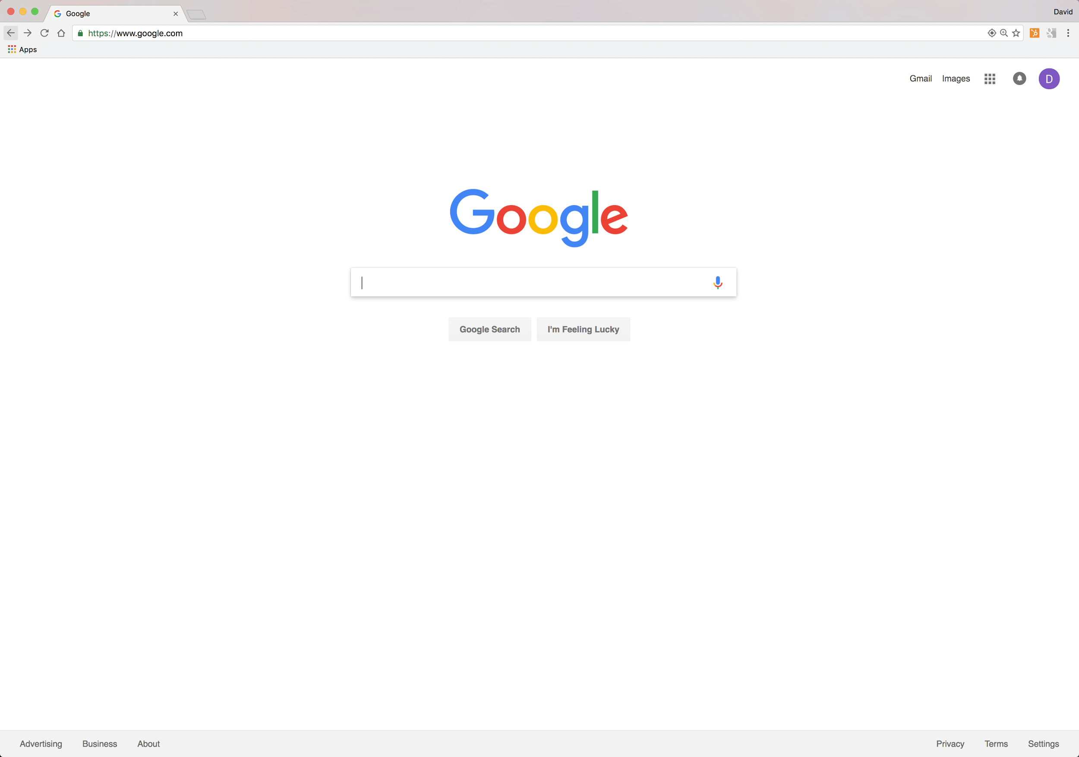
Services
API Manager
All those services
Notes:
We have a lot of Google wide services availble in the cloud console. Maps, Google Apps API. Ads.
But I’m going to highlight some of our most Coolest APIs.

Slide 66
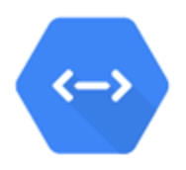
Cloud Endpoints
APIs
Develop, deploy, protect and monitor your APIs
An NGINX-based proxy and distributed architecture
Supports Open API Specification
Notes:
Debugging allows step debugging for a few enviromments on App Engine and Compute Engine.

Slide 67



Machine learning
Using Models
Creating Models
Extending Models
Notes:
So developers neeed to code. They also need reporting, but of a different type than administrators, and they could use services that take care of particularly difficult parts of their job.

Slide 68
Machine learning services
Vision API
Face Detection
Label Detection
Logo Detection
OCR
(Video API beta)
Natural Language API
Syntax Analysis
Entity Recognition
Sentiment Analysis
Multi-Language
Speech API
Automatic Speech Recognition
Streaming
80 languages
Translation API
Language Detection
Translation
Whole document
Notes:
I dunno, have you ever heard us talk about Machine learning APIs features of GCP. I know, the keynotes were full of information. So let me take a quick tour of them.
So you can use Machine learning to make models that can they answer questions? Is this picture a logo, is this tweet negative. We taken some of our most useful models and exposed them directly, our ML apis.
First up, vision API. Vision api analyzes images to detect faces, emotions, landmarks, logos, and can even do OCR.
Natural language API can do syntax and sentiment analysis and can handle a set number of languages.
Speech api converts audio speech into text. It can handle streaming and recognizes 80 languages.
Finally translation api detect language, translate it, and you don’t have to just give it text, you can get whole pages and documents translated.
There are more, we announced video api

Slide 69

Machine learning
Cloud ML Engine
Managed Tensor Flow
Notes:
And finally if you want to make your own models you can use Cloud Machine learning. It’s managed Tensor Flow. It can also self tune, but also be ported to Tensor flow installs on your local workstation.

Slide 70
What-flow?

Slide 71

Machine learning
Tensor Flow
Open Source ML Library
Builds models
Allows you to compute with variable levels of CPU/GPU power
Notes:
And finally if you want to make your own models you can use Cloud Machine learning. It’s managed Tensor Flow. It can also self tune, but also be ported to Tensor flow installs on your local workstation.

Slide 72
Machine Learning
Cloud ML Engine
Managed Tensor Flow
Self-tuning
Portable
Notes:
And finally if you want to make your own models you can use Cloud Machine learning. It’s managed Tensor Flow. It can also self tune, but also be ported to Tensor flow installs on your local workstation.

Slide 73

Kaggle
Your Home For Data Science
Machine Learning competitions
Discover open source datasets
Explore algorithms
Publically share code to other data scientists

Slide 74

Firebase
Complete Mobile Backend Platform
Realtime database
Authentication
Storage
Messaging
Integrates with Cloud Functions

Slide 75

Apigee
Complete API Management
Design, develop, secure API Proxies
Both cloud and on-prem
Fully featured “Developer Portal”
Microservices support
Advanced Analytics

Slide 76

api.ai
Conversational User Experience Platform
Build brand-unique, natural language interactions for bots, applications, services, and devices.
Natural Language Understanding Tools
Integration with other messaging platforms
Cross-platform
Multi-lingual support

Slide 77

Anvato
Video Software Platform
Multi-screen live streaming, video publishing, live and video-on-demand distribution and monetization strategies.
SDKs for multiple client types
Cloud editing
Video encoding
Dynamic ad insertion
Live streaming
Analytics

Slide 78
What’s Next?
┬─┬﻿ ノ( ゜-゜ノ)

Slide 79
What’s Next
Competition
AWS is the leader, followed by Azure and GCP
Look for Google to aggressively compete in this space
Advantages
Big Data and Data Analysis
Machine Learning
Container support
Community and Open-ness (open source)
Investment
Google invested more in their cloud than AWS and Azure combined in 2014
Google is invested heavily in the cloud platform for the future
Notes:
And finally if you want to make your own models you can use Cloud Machine learning. It’s managed Tensor Flow. It can also self tune, but also be ported to Tensor flow installs on your local workstation.

Slide 80
Conclusions
┬─┬﻿ ノ( ゜-゜ノ)

Slide 81
There’s a lot of stuff here
Notes:
I talked about over 40 products. I had 60 minutes. That one every minute and a half. I tried not to make it an auctioneer call.
“Insert auctioneer call about GCP here”
It can be daunting.

Slide 82
Notes:
But now you know what a lot of these mean.
Hopefully you have a clearer path to finding where you need to go.

Slide 83
Thank you

Slide 84
Signing Up
Getting started
Notes:
Okay, computing, you know, doing things, analyzing or sorting stuff.

Slide 85
Getting Started
Signing Up
Notes:
I’m an Application developer at heart, so I’ll start with Computing and Storage. If you got questions, here’s your best opportunity for coherent answers from me. I’ll talk about Big Data here, but it’s not my area of focus, so expect C+ answers here.
Then I’ll talk about Networking, Operations. Answers to questions here: eh.
I’ll finish in Development, with a brief sojourn into Machine learning.

Slide 86
Sign up demo
Let’s get an account
Notes:
Determine if you have time. If you do:
VM screen
Create VM
SSH into it.

